Slide 1
Sidecar savings trial
Can access to sidecar savings improve the financial wellbeing of workers?

Slide 2
© NEST Corporation 2018. All rights reserved. This information is indicative only and may be subject to change. We don’t give any undertaking or make any representation or warranty that this document is complete or error free. We don’t accept responsibility for any loss caused as a result of reliance on the information contained in this document, which is intended to be for guidance only, nor do we accept responsibility for loss caused due to any error, inaccuracy or incompleteness. Reproduction of all or any part of these slides or the information contained in it is not allowed without our permission.
Contact insight@nestcorporation.org.uk for more details.

Slide 3
About NEST Insight
Set up by NEST Corporation to help understand and address the challenges facing NEST’s members, and the new generation of defined contribution(DC) savers.
Has a rich store of data from a previously under-researched population
Works to ensure that these findings are available to the global academic, financial services and public policy communities
Notes:
The NEST Insight unit was set up by NEST Corporation to understand and address the challenges facing NEST’s members, and the new generation of defined contribution (DC) savers.
The scale of the NEST pension scheme, with over 5 million, means the unit is building up a rich store of data from a previously under-researched population, creating a platform from which to drive further insight about savers’ needs and behaviours.
NEST Insight works to ensure that these findings are available to the global academic, financial services and public policy communities.

Slide 4
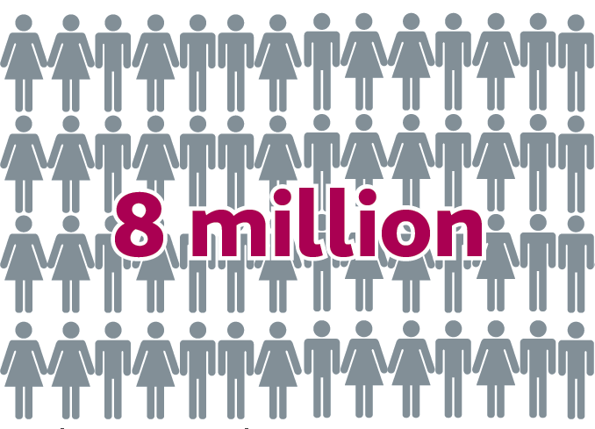
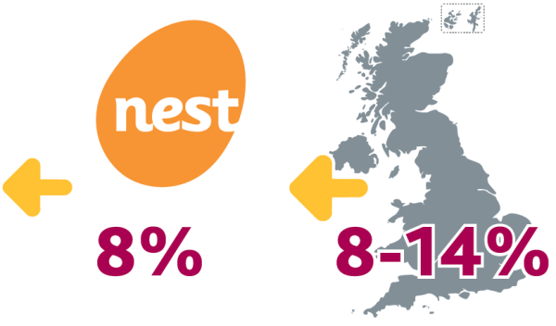
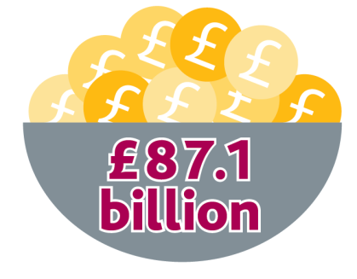
What’s the problem we’re trying to solve?
So far auto enrolment has been a huge success…
Sources: The Pensions Regulator (2017), NEST Corporation (2017), The Pensions Policy Institute (2016)
Notes:
So far auto enrolment has been a huge success:
over 8 million people are newly saving, or saving more, for their retirement
£87.1 billion was saved by eligible workers during 2016
opt out levels have remained low at NEST and throughout the UK
since auto enrolment began in 2012, private sector saving has increased by 31 per cent.

Slide 5
However, whilst many low to medium earners are now building up meaningful retirement savings, some have little or no money put aside for emergencies
Sources: Money Advice Service (2016) and Department for Work and Pensions (2017)
Notes:
However, whilst many low to medium earners are now building up meaningful retirement savings, some have little or no money put aside for emergencies.
In spite of initiatives to incentivise liquid savings, only 42 per cent of working-age adults have £500 or more on hand and 26 per cent have no savings at all.

Slide 6
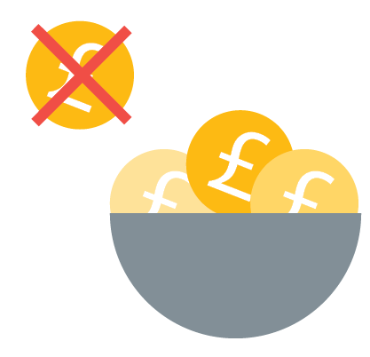
How does a lack of liquidity affect your workers?
When a high or unexpected cost occurs, it can have a severe impact on people who don’t have enough ‘emergency savings’ put aside. We call this a ‘financial shock’.
Notes:
When a high or unexpected cost occurs, it can have a severe impact on people who don’t have enough ‘emergency savings’ put aside. We call this a ‘financial shock’.
In order to cover the cost of a car repair, for example, people in this situation may have to:
cancel pension contributions
reduce spending on essentials, such as food
borrow money from friends and family
take out costly payday loans or use a credit card
not fix the car, which may mean they’re unable to get to work and will incur a loss of earnings.

Slide 7
Impacts on wellbeing and productivity
Four in ten workers say money worries have made them feel stressed over the last year
A quarter of workers say they have lost sleep over money worries
One in eight workers report that money worries have affected their ability to concentrate at work
One in twenty workers have missed work in the last year due to money worries
Source: Social Market Foundation (2016)
Notes:
High-cost and unpredictable one-off expenses can cause acute short-term financial hardship for people whose disposable income after essentials is low.⁷
If not managed carefully, debts among low income groups can also lead to debt spirals which can cause acute financial stress. Any severe or persistent money pressures can have a detrimental effect on health, which can in turn affect productivity and earning capacity.⁸
Sources:
⁷ Money Advice Service (2016) and Packman, C. (2017)
⁸ Money Advice Service, op cit; Chartered Institute of Personnel and Development (2017)

Slide 8
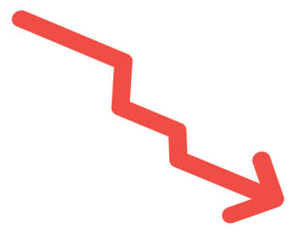
When employers were asked about the effects of poor financial wellbeing amongst workers:
54 per cent said it’s had an impact on workers’ behaviour
56 per cent said it’s had an impact on job performance
56 per cent said it’s had an impact on relationships at work
56 per cent said it’s had on workers’ relationships with management
Source: Neyber (2017)

Slide 9
Hybrid products: the sidecar model
Payroll contributions
Savings cap
Rainy day
fund
Pension pot
Notes:
An alternative is to think about how to create an experience which fits with the saver’s psychology and preferences, for example a solution that feels like a single ‘product’ but contains within it distinct ‘jars’ for different purposes.
US researchers have proposed a hybrid savings product which combines liquid ‘emergency savings’ in a sidecar account, with a traditional, illiquid, DC retirement savings product.
How would the sidecar model work?
Contributions would be managed through a mechanism designed to create an optimal level of liquid savings, while also maximising long-term savings. This would be administered as follows:
Contributions paid into the combined account structure would at first be distributed between the liquid and illiquid accounts.
2. When the balance in the liquid account reaches a predetermined savings cap, all contributions would start ‘rolling’ into the illiquid retirement account.
3. If at any point the saver withdraws funds from the liquid account, and so reduces the balance to a level below the savings cap, future contributions would once again start being divided between the liquid and illiquid accounts.

Slide 10
Benefits of the sidecar model
Uses the idea of ‘set and forget’
Allows the pension pot to remain ‘locked up’
Helps to build short-term resilience
Could increase the amount saved for retirement
Notes:
The product would be offered through payroll deduction in the workplace, using the idea of ‘set and forget’ to create a persistent flow of contributions to savings.
The approach would allow the pension pot to remain locked up, and invested for the long term, while giving workers access to an amount of ‘emergency’ liquid savings to help build short-term resilience.
Under this model, total contributions through payroll would be set higher than the auto enrolment minimum. This has the advantage of increasing the total amount saved, and therefore preserving the build-up of auto enrolment contributions, while potentially increasing retirement savings in the long term if the threshold is reached.

Slide 11
The research programme

Slide 12
Working in partnership
The JPMorgan Chase Foundation and the Money Advice Service (MAS) will be providing support for the trial.
MAS will also be working with NEST Insight directly on the research, along with Professor Brigitte Madrian and the Harvard Kennedy School.
The sidecar account will be provided by Salary Finance, working alongside a NEST pension pot.
NEST Insight is looking for large employers to participate in the research trial.

Slide 13
What are NEST Insight aiming to find out?
Can creating a link between liquid and illiquid savings create an appropriate balance of overall liquidity, and enhance the financial wellbeing of savers?
Would people take the idea up?
Would they limit themselves to ‘emergency’ use of the sidecar account or would it become another current account?
Would balances reach the threshold and lead to increased retirement savings?
Would the availability of the sidecar lead to more optimal responses to financial emergencies, such as reducing reliance on high-cost debt?
Notes:
The aim of this research is to examine whether creating a link between liquid and illiquid savings can create an appropriate balance of overall liquidity, and enhance the financial wellbeing of savers.
Since the concept has not been tested, we do not yet know whether the theory underpinning the concept would be borne out in practice.

Slide 14
Field trial
Stage two will test the combined liquid and illiquid structure with workers of a number of large UK employers.
The trial, which will be a longitudinal study, will be designed to test a range of factors:
take up rates for the liquid account
levels of savings within the liquid account
impact on participants’ financial well-being

Slide 15
Want to find out more?
Contact Matthew Blakstad
Email: matthew.blakstad@nestcorporation.org.uk
Call: 020 3056 3795
Read NEST Insight’s discussion paper

Slide 16
References
Department for Work and Pensions (2017) Family Resources Survey. London: Department for Work and Pensions
Money Advice Service (2016) UK Financial Capability Strategy for working-age people. London: Money Advice Service
NEST Corporation (2017) unpublished scheme member data as at September 2017.
Neyber (2017) The DNA of Financial Wellbeing. London: Neyber Ltd.
Social Market Foundation (2016). Working well: how employers can improve the wellbeing and productivity of their workforce. London: Social Market Foundation.
The Pensions Policy Institute (2016) The impact of automatic enrolment in the UK as at 2016. London: The Pensions Policy Institute
The Pensions Regulator (2017) Automatic enrolment commentary and analysis: April 2016 - March 2017. London: The Pensions Regulator
The Pensions Regulator (2017) Automatic enrolment passes the eight million milestone http://www.thepensionsregulator.gov.uk/press/automatic-enrolment-passes-the-eightmillion-milestone.aspx, accessed 10/08/2017
Packman, C. (2017) Savings for the Future: Solving the Savings Puzzle for Low Income Households. London: Toynbee Hall

